Slide 1

How to write a machine learning related scientific article
Author
Comănac Dragoș-Mihail

Slide 2


Why?
Notes:
First of all, why I considered this topic interesting and important
Rigurous way of presenting results
Hard at first, especially for computer science people

Slide 3

Placement in the broader field
Notes:
Vast and complex field
Infer some mapping between pairs of data
Main approaches supervised and unsupervised

Slide 4
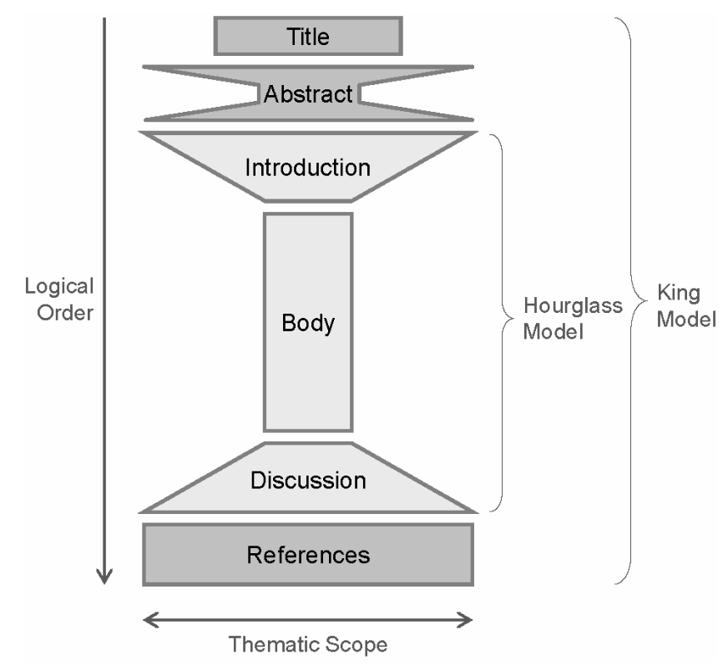
How?
Notes:
The king model
Covers the structure of a scientific paper

Slide 5
Title
Notes:
Attention-grabbing
Clear and concise summary of the paper
It should be clear what is the purpose of the research
It is important to use key terms, but not jargon
If jargon is used, the target audience should be considered
It is important to invest time in designing the title as it can have a significant impact on the reader

Slide 6
Abstract
Notes:
Essentially a summary of the paper aim, results and conclusions
Compressed hourglass model
No references
Not too lengthy
Usually written after the rest, but some write it first to have an idea
Goes from general to specific and back to general

Slide 7
Introduction
Notes:
First section of the actual paper, starting from a general, and introducing the specifics
Should provide background
Establish the importance of the paper
Clearly state the hypothesis
It can provide an overview of the structure of the paper
Should be interesting in order to encourage the reader to continue

Slide 8
Body
Notes:
Next is the body, which, as we can see it is slim, therefore specific
Backbone of the paper
Highlights the key points of the research
In the context of machine learning
Literature review in which other relevant methods are presented
The method or learning algorithm
Methodology how to apply the method – processing of the data, training loop, hyperparameter search
Result and comparison with the existing literature important to use the same metrics on the same data

Slide 9
Discussions
Notes:
Ending part
Goes from specific to general
Meaning that the main findings should be presented and try to place them in the bigger picture
Future work, limitations of the study

Slide 10
References
Notes:
List of works that are important for the research
Have a specific format, containing various information such as the author or where and how it was published
Can be an indicator for the quality of the research

Slide 11


Dissemination
Notes:
Conferences
Journals
Other such as social media or repositories

Slide 12
Conclusions
Notes:
In conclusion, I think that this work could be useful as a guide for beginners in research that are looking to improve their writing skills, and that most parts can be extended to other domains as well.

Slide 13
Thank you!

